Slide 1

Table of Contents
1. Introduction
2. The Problem
3. Elysium's Solution
4. Our Offerings
5. Target Customer: Developers
6. Capital Raise
7. Summary

Slide 2


Slide 3

Greetings!
Welcome, Chris Dixon! We are excited to present Elysium AI, a game-changing platform for developers.

Slide 4
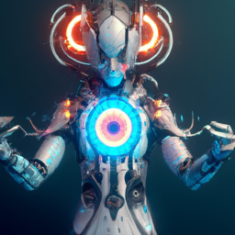
The Problem
Fragmented AI Agents hinder collaboration, efficiency, compatibility, entry, and security. Disjointed experiences and inconsistent protocols limit adoption.

Slide 5

Elysium's Solution
Elysium offers a seamless user experience, dynamic ecosystem integration, a unified AI network, and a secure platform. We empower developers to build secure, decentralized AI tailored to individual needs.

Slide 6

Our Offerings
Elysium OS provides a unified portal for accessing personalized AI Butler or Chief of Staff. Automation Station streamlines AI Agent recruitment and deployment. Experience automation, simplified.

Slide 7

Target Customer: Developers
We solve the shared problem of inaccessible and unconnected AI Agents. Elysium OS and Automation Station serve as value-added catalysts for developers, providing a single entry point and a marketplace for transactions.

Slide 8

Capital Raise
We are raising $3,500,000 in our Seed round to hire key talent, fuel growth through marketing channels, and complete platform development for a successful public launch.

Slide 9

Summary
Elysium AI empowers developers with a personalized AI symphony. Our platform addresses the fragmentation in AI, provides seamless user experiences, and offers a secure and efficient ecosystem. Join us in revolutionizing AI development.

